Slide 1
Extracting Causal Relations from Electronics & Supply Chain News
Fiona Anting Tan Institute of Data Science National University of Singapore, Singapore tan.f@u.nus.edu
6th Apr 2023
Notes:
To extract the hidden pattern in data to understand the interrelation between factors—in future to establish causality

Slide 2
Agenda
Temporal Extraction – Literature Review
Timeline
Other Topics

Slide 3
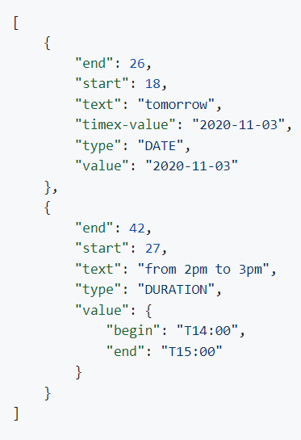
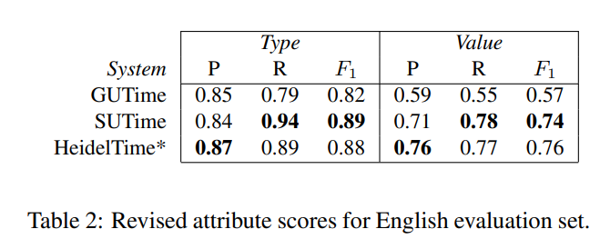
Temporal Extraction – Lit Review
Input Text: “I need a desk for tomorrow from 2pm to 3pm”
Output:
SUTime (Chang and Manning, 2012 & 2013)
Library for recognizing and normalizing time expressions
Output: TIMEX3 for type and value
Data: TempEval-2
https://nlp.stanford.edu/software/sutime.shtml
https://github.com/FraBle/python-sutime

Slide 4
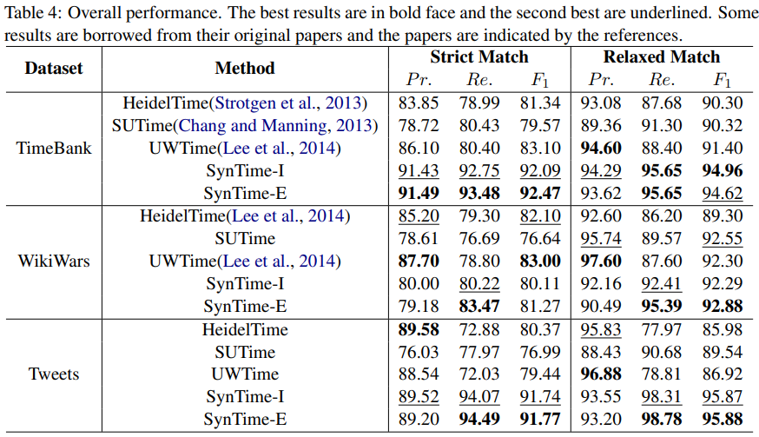
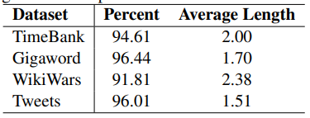
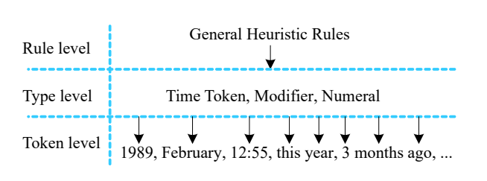
Temporal Extraction – Lit Review
SynTime (Zhong et al., 2017)
Code for recognizing time expressions
Output: Time Token, Modifier, Numeral
Data: Timebank, Gigaword, WikiWars, Tweets
https://github.com/zhongxiaoshi/syntime

Slide 5
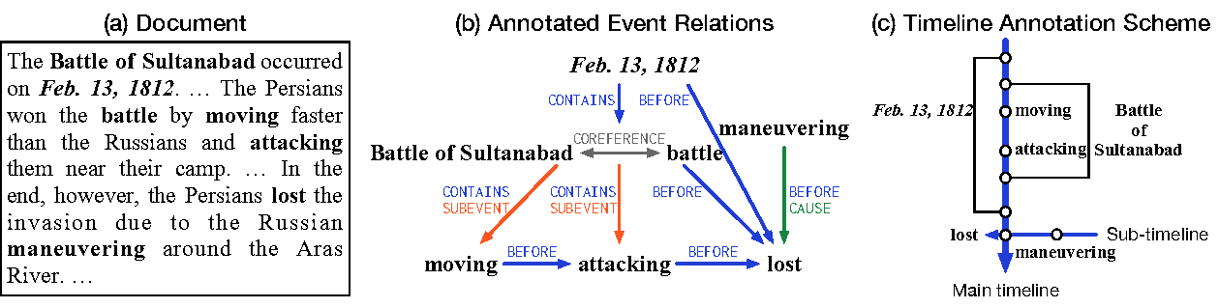
Temporal Extraction – Lit Review
MAVEN-ERE (Wang et al., 2022)
Unified large-scale dataset for events relation extraction with baseline codes, data sizes:
103,193 coreference chains,
1,216,217 temporal relations,
15,841 subevent relations,
57,992 causal relations
https://github.com/THU-KEG/MAVEN-ERE

Slide 6
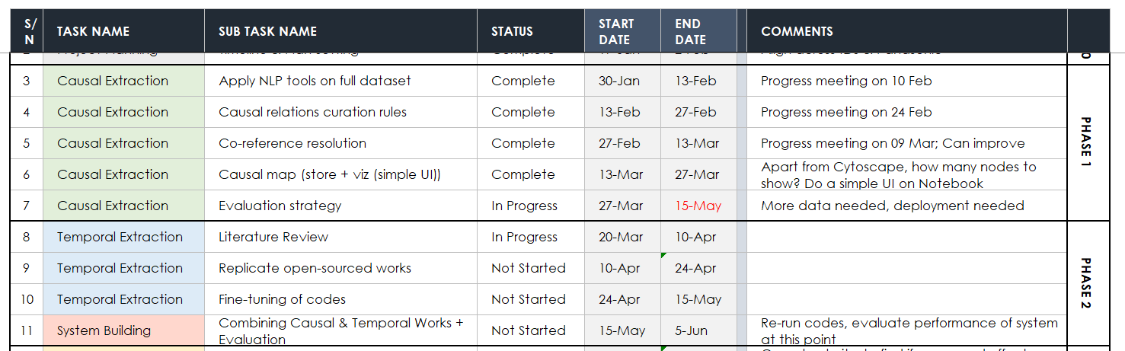
Timeline
Notes:
"D:\66 CausalMap\Panasonic_Electronic_KG\Panasonic_Timeline.xlsx"

Slide 7
Evaluation
For Extraction
Annotate 10 articles (from one topic) with Cause-Effect spans
Evaluate 100 extracted causal relations’ sanity (Labels: Pass/Fail)
For Clustering
From the 10 articles, identify clustering of spans. Compare the ideal human-annotated graph vs. automatically extracted one.
Evaluate 100 nodes’ clustered spans’ sanity (Labels: Pass/Fail)
Use-Case Dependent
New article report: Extract events, identify possible effects (+Links to old articles)
End-of-month report: Summarize new/top cause-effects
Evaluate usefulness of each report
Notes:
Should we continue to do these? In anticipation of resubmission/ another paper. Esp since B, we found we needed much more data.
Alternatively, can we brainstorm on how to do #A2 and #B2? Can we integrate into the deployment? Users click TICK / CROSS directly?

Slide 8
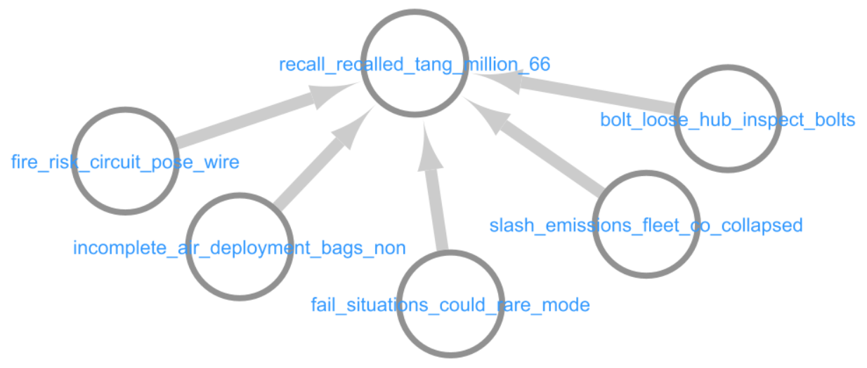
Node readability
Pre-filtering: Topic label generation (E.g.BART-TL (Popa and Rebedea, 2021)
Post-filtering: If the node contains only one span, we could reflect the span directly (i.e. no topic generation needed)
E.g. Qn. “Why did companies recall their vehicles?”
the risk of fire
to replace a wheel hub bolt
not meeting federal tail pipe emission standards
air bag non-deployment concerns in 2018
the vehicles could catch fire while parked and turned off
Notes:
https://huggingface.co/cristian-popa/bart-tl-ng
https://aclanthology.org/2021.eacl-main.121.pdf

Slide 9
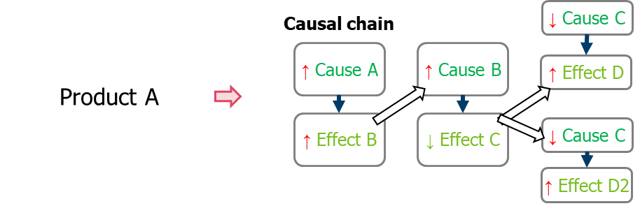
Discussion
Causal relations curation rules: All, add levels to the CE extracted
Prototype data size: Full dataset, or split by quarters
Evaluation strategy: In Progress
Product identification
Temporal & sentiment aspect : In Progress
Importance of other relation types
Cross-sentence relations
Source: Panasonic Industry
Notes:
Review/ Summary Slide

Slide 10
CONCLUSION

